Slide 1
Computer Arch. a Quantitative Approach 5th Edition
Chapter 1
Fundamentals of Quantitative Design and Analysis
Phillip Kamau
SCT212-0048/2021

Slide 2
1.1 Introduction
Performance improvements:
Improvements in semiconductor technology
Feature size, clock speed
Improvements in computer architectures
Enabled by High Level Language compilers, UNIX
It lead to RISC architectures
Together they have enabled:
Lightweight computers
Productivity-based managed/interpreted programming languages

Slide 3
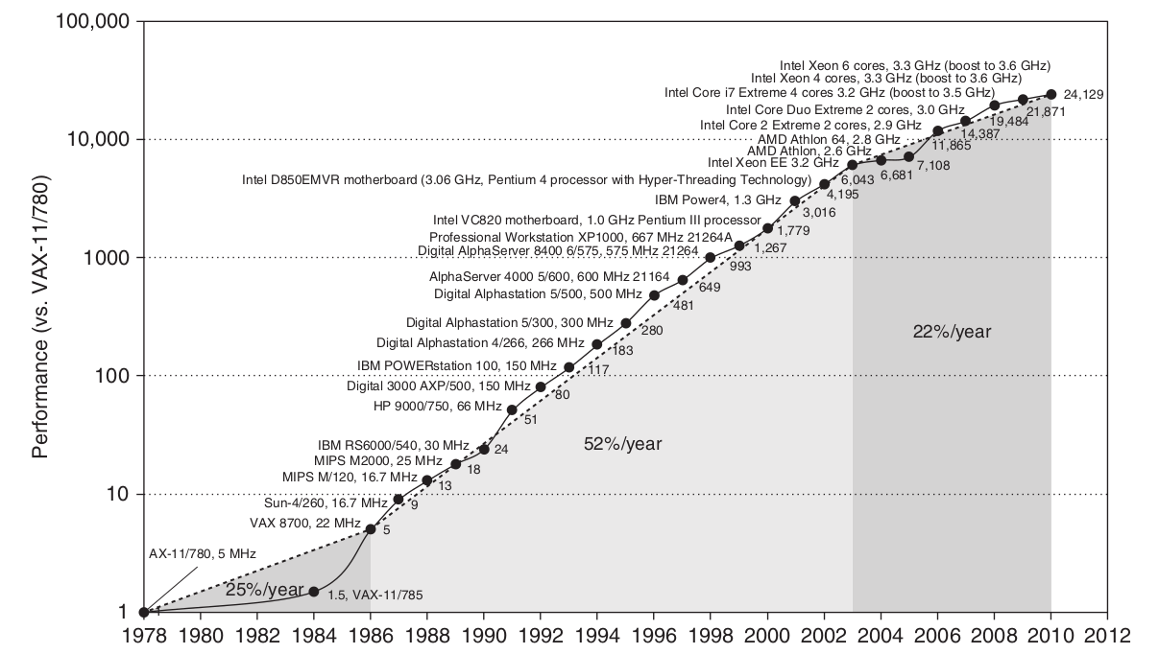
Single Processor Performance
Move to multi-processor
RISC

Slide 4
Current Trends in Architecture
Cannot continue to leverage Instruction-Level parallelism (ILP)
Single processor performance improvement ended in 2003
New models for performance:
Data-level parallelism (DLP)
Thread-level parallelism (TLP)
Request-level parallelism (RLP)
These require explicit restructuring of the application

Slide 5
1.2 Classes of Computers
Personal Mobile Device (PMD)- emphasis is on energy efficiency and real-time. e.g smart phones, tablet computers
Desktop computing- emphasis is on price-performance
Servers- emphasis is on availability, scalability and throughput
Clusters/ Warehouse Scale Computers-
used for SaaS
emphasis is on availability and price-performance
Sub-class: supercomputers, emphasis: floating-point performance and fast internal networks
5. Embedded Computers - emphasis is on price
Feature | Personal mobile device (PMD) | Desktop | Server | Clusters/warehouse-scale computer | Embedded
Price of system | $100–$1000 | $300–$2500 | $5000–$10,000,000 | $100,000–$200,000,000 | $10–$100,000
Price of micro-Processor | $10–$100 | $50–$500 | $200–$2000 | $50–$250 | $0.01–$100
Critical System Design Issues | Cost, energy, media performance, Responsiveness | Price- performance, energy, graphics Performance | Throughput, availability, scalability, energy | Price-performance, throughput, energy Proportionality | Price, energy, application specific Performance

Slide 6
Parallelism
Classes of parallelism in applications
Data-Level Parallelism (DLP)
Tak-Level Parallelism (TLP)
Classes of architectural parallelism
Instruction-Level Parallelism (ILP)
Vector architectures/Graphical Processor Units (GPUs)
Thread-Level Parallelism
Request-Level Parallelism

Slide 7
Flynn’s Taxonomy
Single instruction stream, single data stream (SISD)
Single instruction stream, multiple data streams (SIMD)
vector architectures
Multimedia extensions
Graphics processor units
Multiple instruction streams, single data stream (MISD)
No commercial implementation
Multiple instruction streams, multiple data streams (MIMD)
Tightly-coupled MIMD
Loosely-coupled MIMD

Slide 8
1.3 Defining Computer Architecture
“Old” view of computer architecture:
Instruction Set Architecture (ISA) design
i.e. decisions regarding:
registers, memory addressing, addressing modes, instruction operands, available operations, control flow instructions, instruction encoding
“Real” Computer architecture
specific requirements of the target machine
Design to maximize performance within constraints: cost, power and availability
Includes ISA, microarchitecture, hardware

Slide 9
Organization, Hardware and Architecture
Organization: includes the high-level aspects of a computer’s design
memory system, the memory interconnect and the design of the internal processor or CPU (architecture, logic, branching and data transfer).
E.g. AMD Opteron 64 and Intel P4 have same ISA but they have different internal pipeline and cache organizations.
Hardware: detailed logic design and the packaging technology.
E.g. P4 and mobile P4 have the same ISA and organization, but they have different clock frequency and memory system.
Architecture: covers all three aspects of computer design - instruction set architecture, organization and hardware.
Designer must meet functional requirements as well as price, power, performance and availability goals.

Slide 10
1.4 Trends in Technology
A successful new ISA may last decades, for example, IBM mainframe.
There are four critical technologies:
Integrated circuit logic technology- transistor density increased by about 35% per year quadrupling in somewhat over four years
Semiconductor DRAM(Dynamic Randon-Access Memory)- capacity increases by about 40% per year doubling roughly every two years.
Magnetic disk technology- roller coaster of rates, disk are 50-100 times cheaper per bit than DRAM.
Network technology- network performance depends both on the performance of switches and transmission.

Slide 11
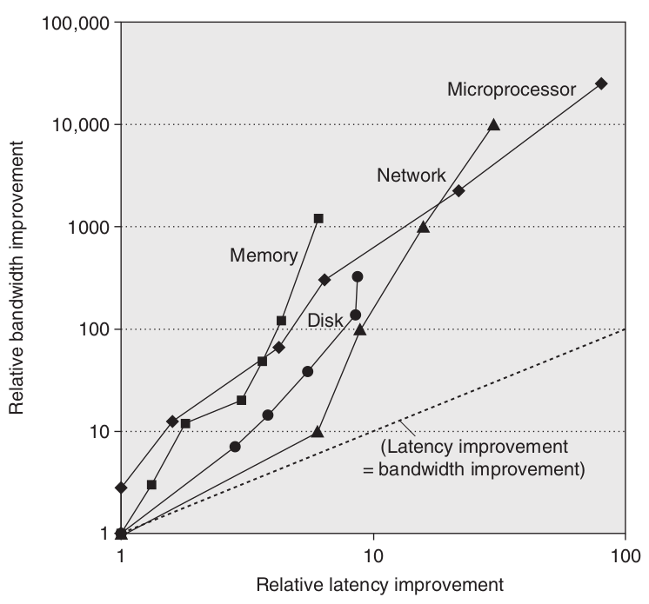
Performance Trends: Bandwidth over latency
Bandwith or throughput: the total amount of work done in a given time.
such as megabyte per second for a disk transfer
Latency or response time: the time between the start and the completion of an event
Such as milliseconds for a disk access

Slide 12
Scaling of Transistor Performance and wires
Feature size- the minimum size of a transistor or a wire in either the x or y dimension.
From 10 microns in 1971 to 0.32 microns in 2011.
The density of transistors increases quadratically with a linear decrease in feature size.
Transistor performance improves linearly with decreasing feature size
Since improvement in transistor density, thus CPU move quickly from 4-bit to 8-bit to 16-bit to 32-bit microprocessors.
Signal delay for a wire increases in proportion to the production of its resistance and capacitance.

Slide 13
1.5 Trends in Power in Integrated Circuits
Power also provides challenges as devices are scaled.
Dynamic power (watts, W) in CMOS chip - the traditional dominant energy consumption has been in switching transistors.
Power_{dynamic} = 1 ⁄ 2 x Capacitive load x Voltage² x Frequency switched
In modern VLSI, the exact power measurement is the sum of:
Power_{total} = Power_{dynamic} + Power_{static} + power_{leakage}
For mobile devices they care about battery life more than power so energy is the proper metric, measured in joules:
Energy_{dynamic} = Capacitative load x Voltage²
Hence lower voltage can reduce Power_{dynamic} and Energy_{dynamic} greatly. (In the past 20 years, supply voltage is from 5V down to 1V)

Slide 14
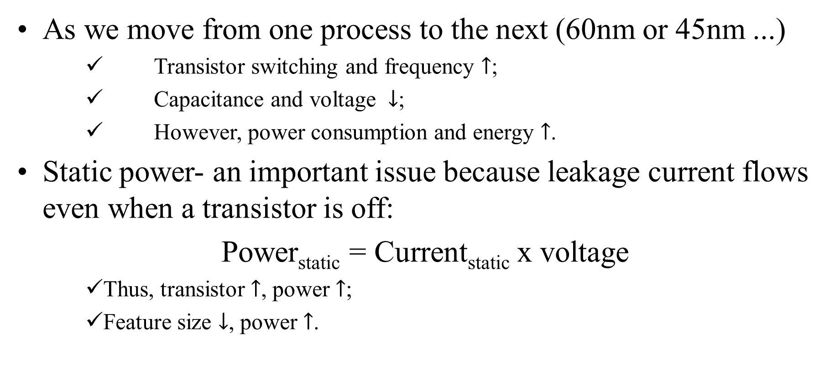
As we move from one process to the next (60nm or 45nm ...)
Transistor switching and frequency $↑$;
Capacitance and voltage $↓$;
However, power consumption and energy $↑$.
Static power- an important issue because leakage current flows even when a transistor is off:
Power_{static} = Current_{static} x voltage
Thus, transistor $↑$, power $↑$;
Feature size $↓$, power $↑$.

Slide 15
1.6 Trends in cost
Cost driven down by learning curve
Yield
DRAM- price closely tracks cost
Microprocessors- price depends on volume
10% less for each doubling of volume

Slide 16
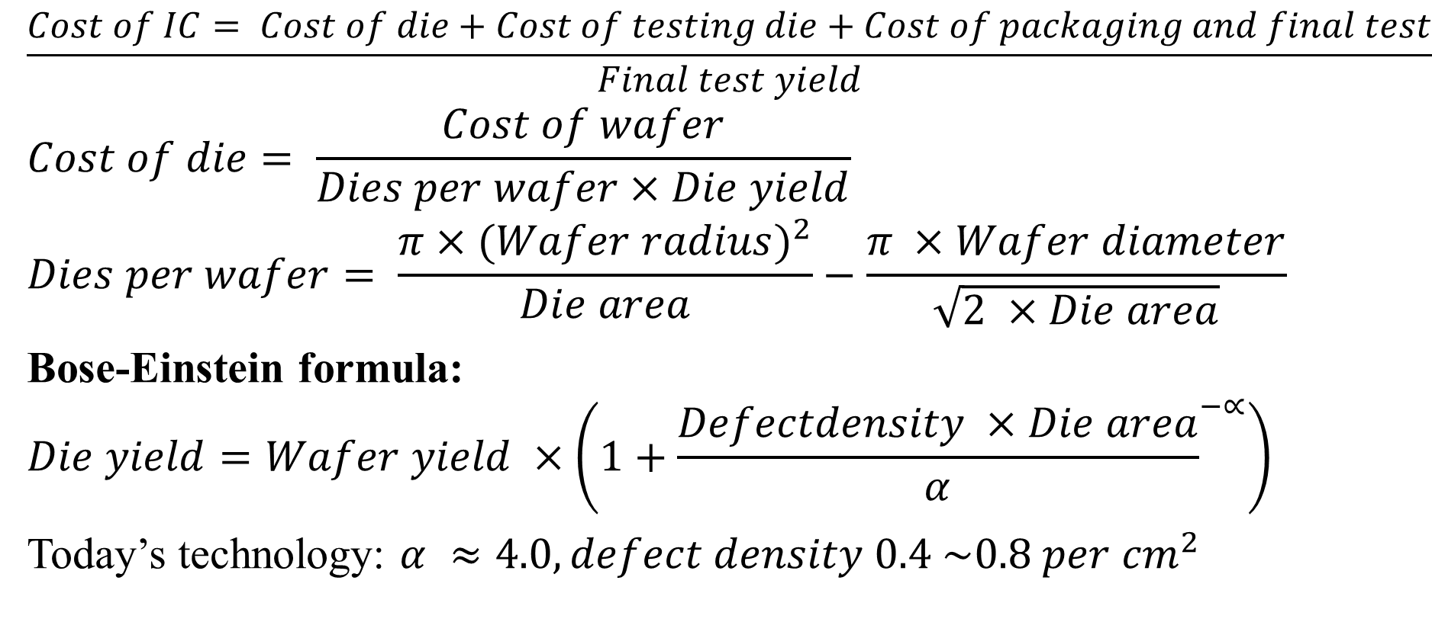
Cost of an Integrated Circuit (IC)
$$\frac{Cost of IC= Cost of die+Cost of testing die+Cost of packaging and final test}{Final test yield}$$
$$Cost of die= \frac{Cost of wafer}{Dies per wafer×Die yield}$$
$$Dies per wafer= \frac{π×{(Wafer radius)}^{2}}{Die area}−\frac{π ×Wafer diameter}{\sqrt{2 ×Die area}}$$
Bose-Einstein formula:
$$Die yield=Wafer yield ×\left(1+{\frac{Defectdensity ×Die area}{α}}^{−∝}\right)$$
Today’s technology: $α ≈4.0, defect density 0.4 \sim 0.8 per {cm}^{2}$

